Slide 1


28th National Take Back Day
April 26, 2025
DRUG ENFORCEMENT ADMINISTRATION
DIVERSION CONTROL DIVISION

Slide 2
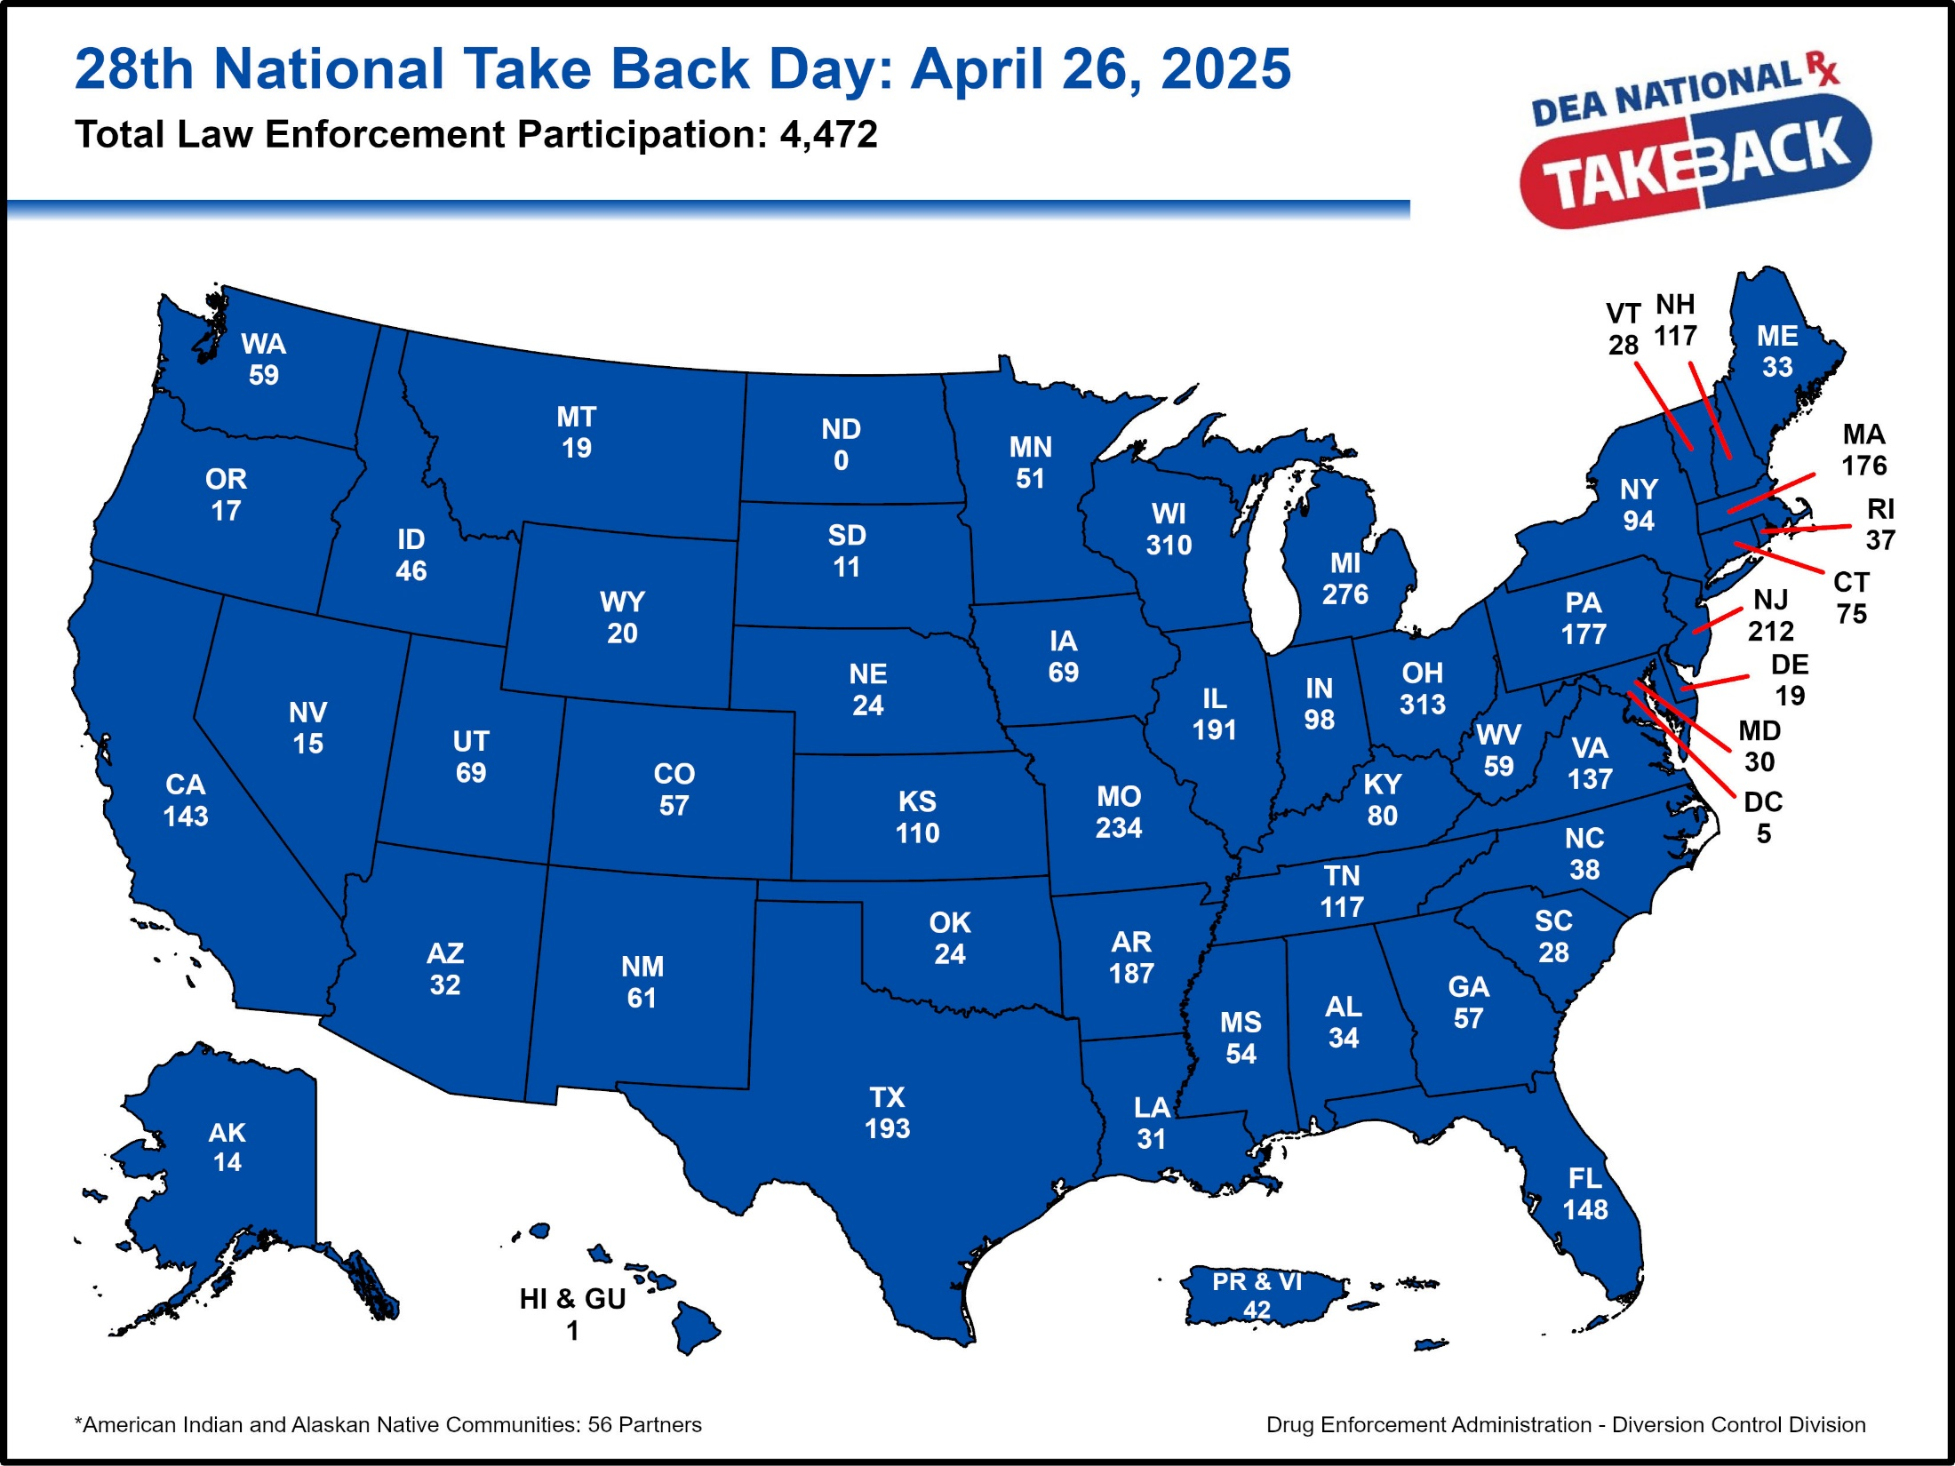

Slide 3


Slide 4
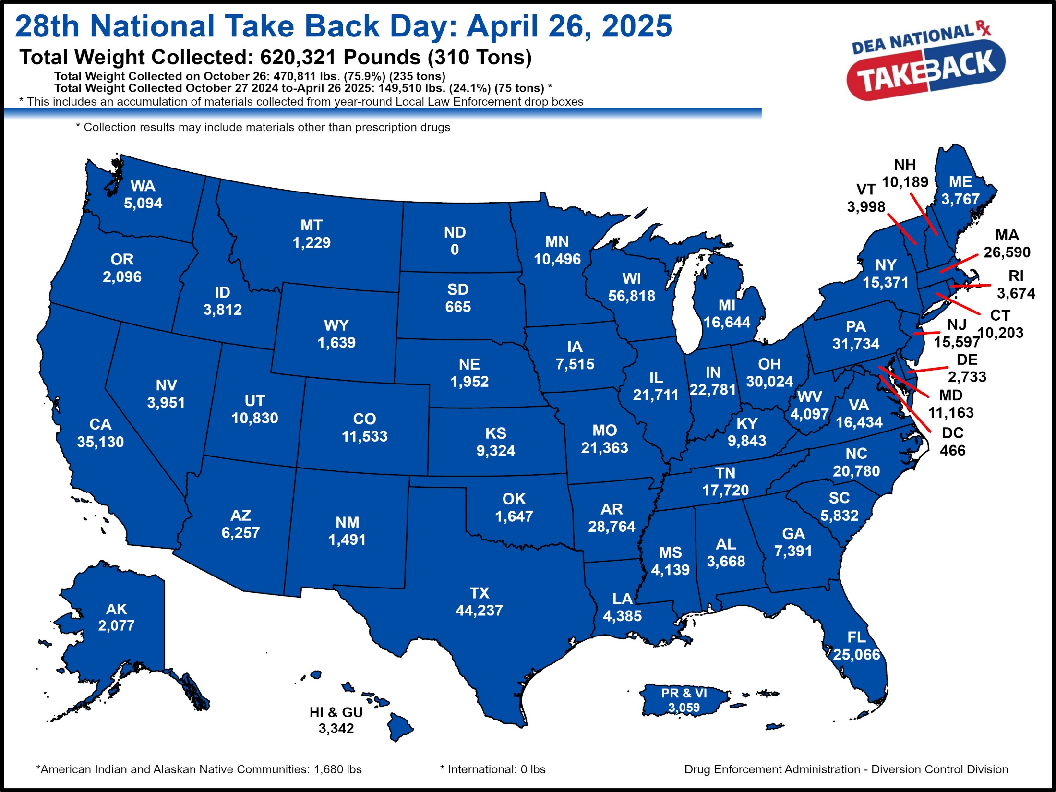
April

Slide 5
