Slide 1


20th National Take Back Day
April 24, 2021
DRUG ENFORCEMENT ADMINISTRATION
DIVERSION CONTROL DIVISION

Slide 2
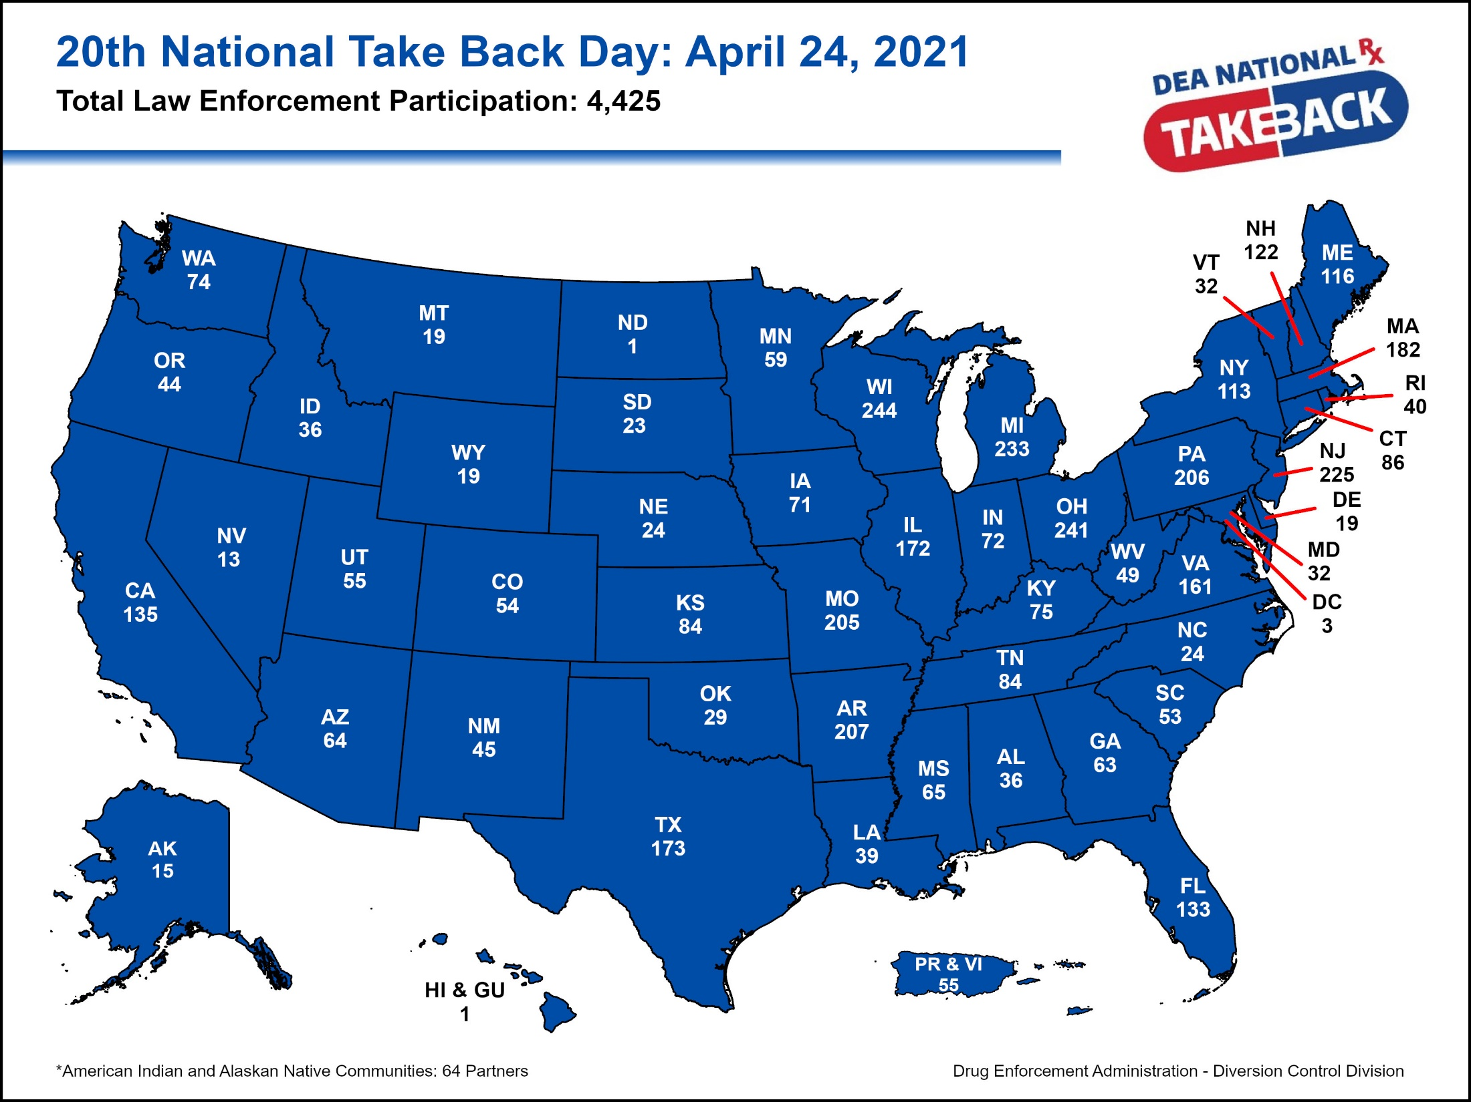

Slide 3


Slide 4
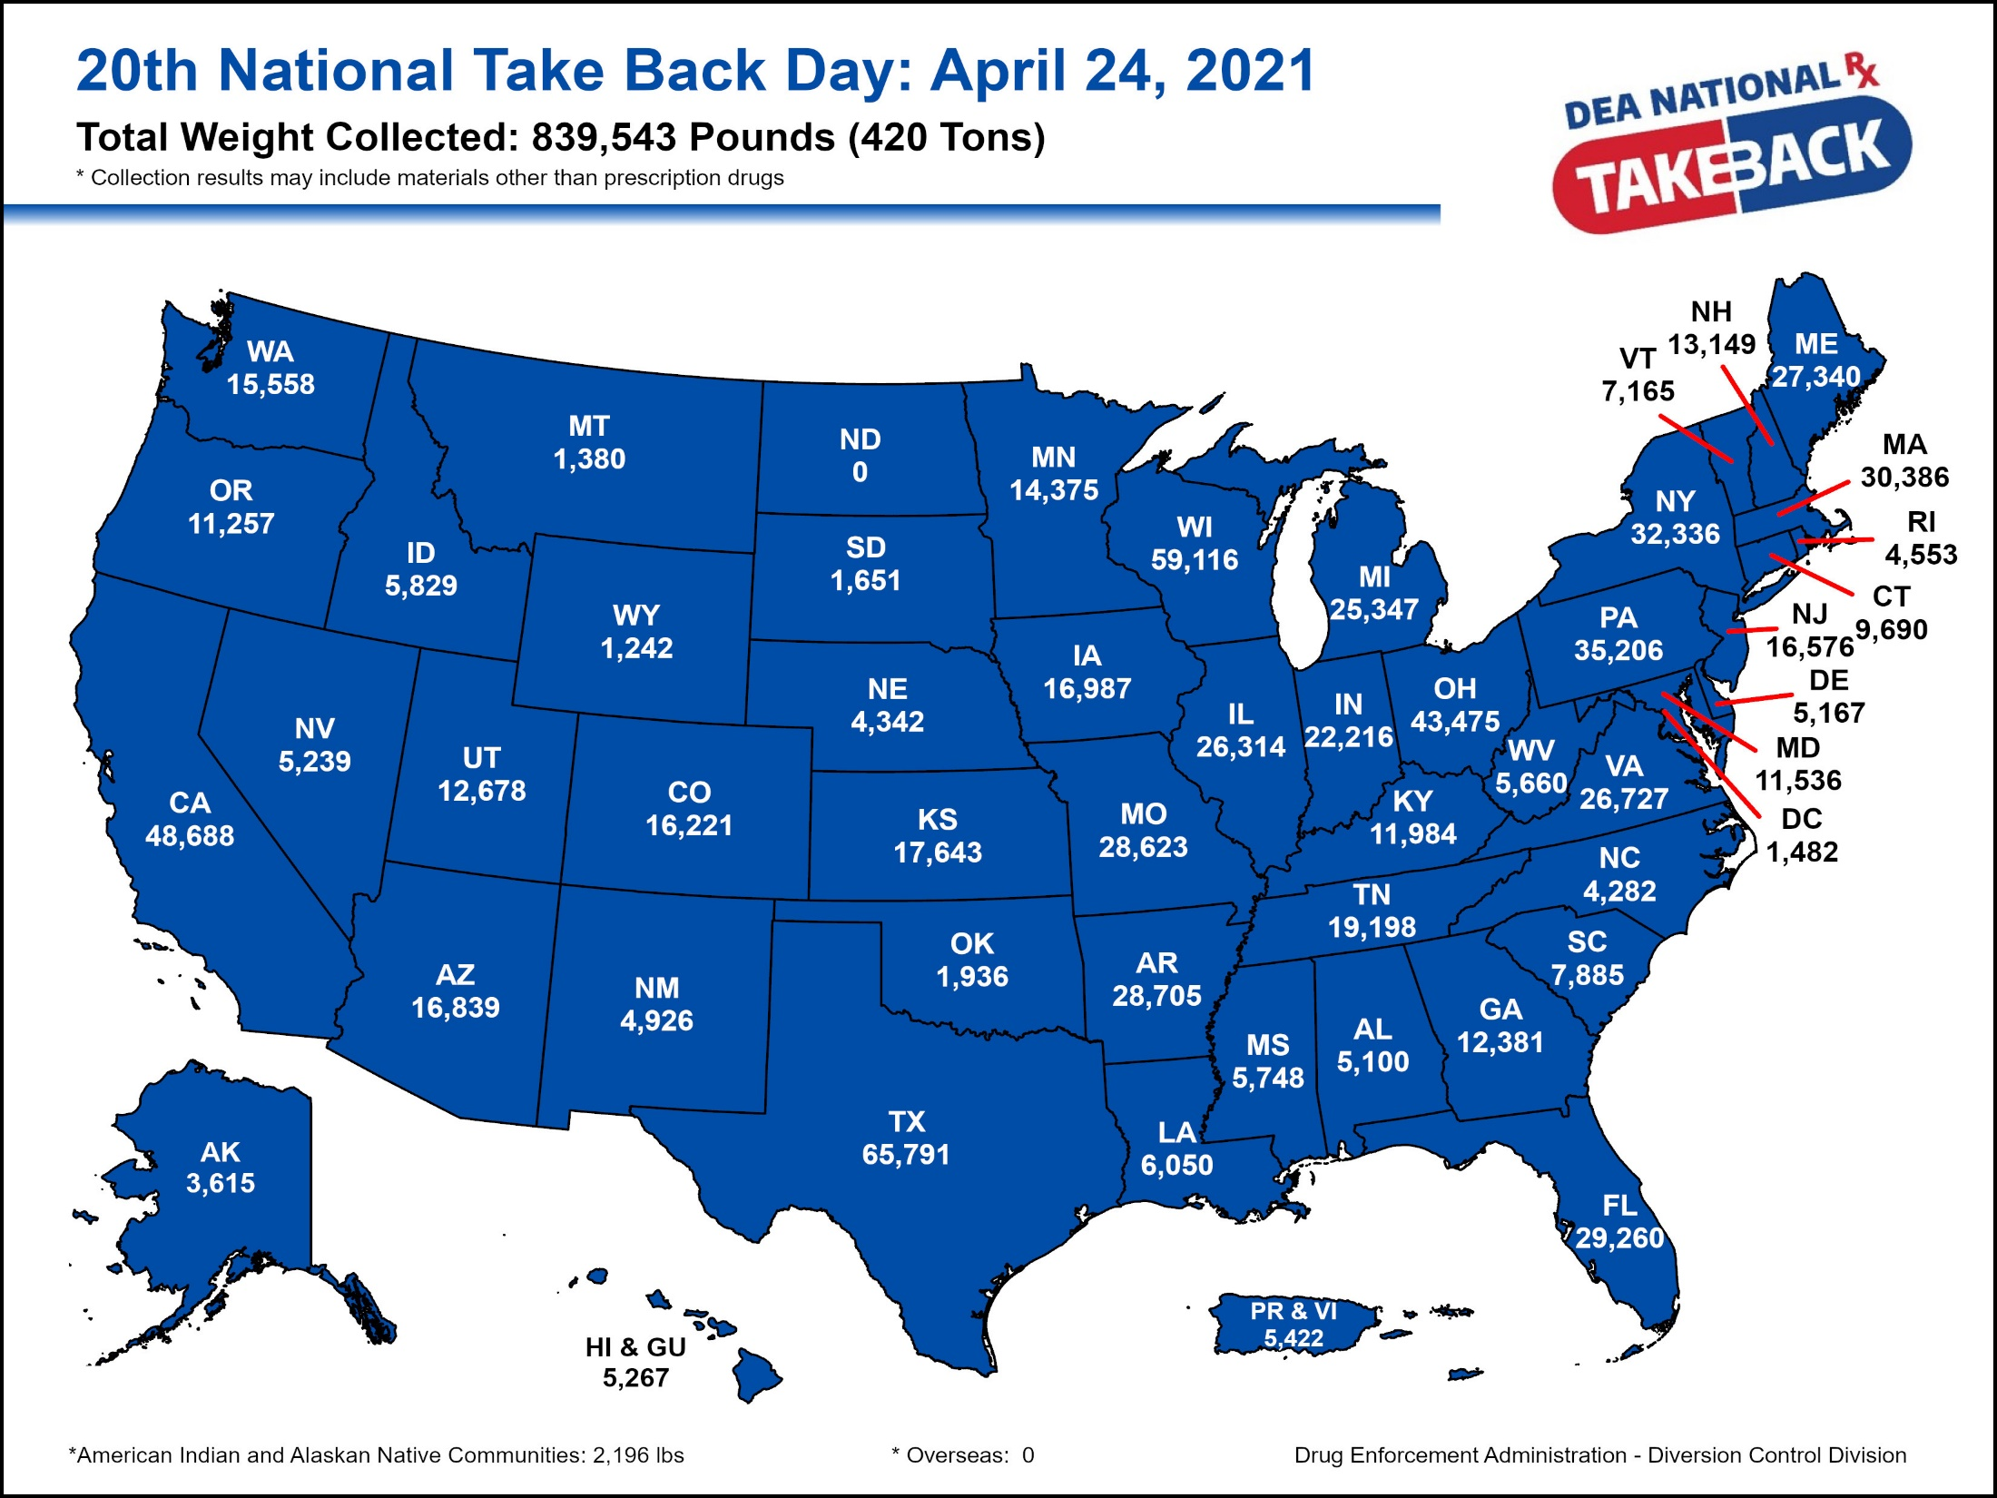

Slide 5
